Slide 1
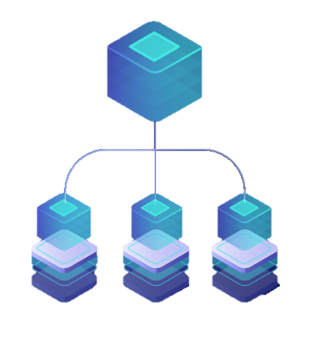
Developing Microservices with Containers, Kubernetes and Microsoft Azure
DATE
2nd to 5th Nov 2020

Slide 2
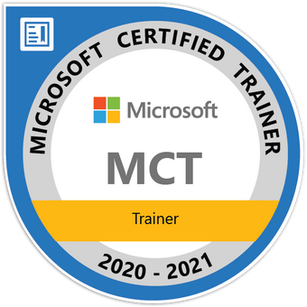


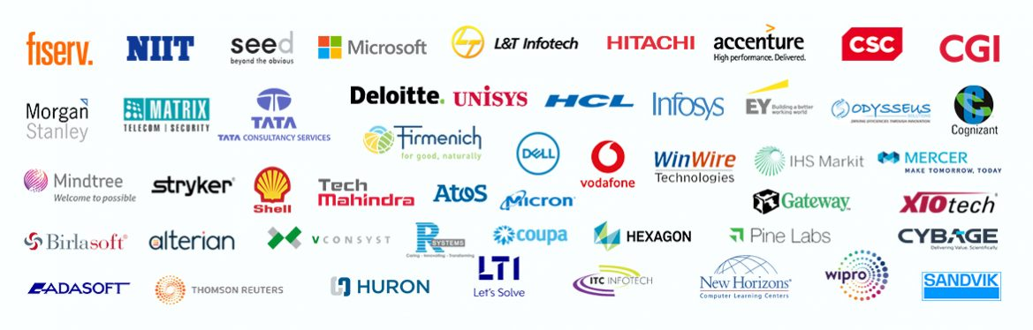
Maruti Makwana
Microsoft Certified Trainer

Slide 3
Developing Microservices with Containers, Kubernetes and Microsoft Azure
Session AGENDA
Containers
What is this Container-thing developers are talking about. And why should you use it? In this module you will get an overview of what containers are, and how to use them on and with Windows and Linux.
Docker
A container needs to be hosted and run on a container runtime. Multiple options exist here like rkt, CloudFoundry cr, ... In this course we will focus on the most popular one: Docker. You will learn how to create, run and scale containers using Docker.
Add ASP.NET Applications to Containers
Now that you know what a container is, how do you get your applications in a container? You will learn how to create Docker containers with your application in it. We will start by migrating existing applications, and then move to creating multiple services orchestrated for working together.

Slide 4
Azure for Container Overview
Azure has many constructs that have to do with containers and microservices. It's a bit overwhelming, really. This topic will help you separate the sheep from the goats, to figure out exactly what you need.
Microservice Architecture
How do you chop your application into multiple smaller components, called "microservices", and why would you do that? We will show how to create microservice-applications, and introduce you to some key concepts of microservices like data isolation, resiliency and communication.
Kubernetes
When using containers for microservices, you will end up with many containers on many machines. Kubernetes is an open-source endeavor for handling this job. In this topic we dive into this popular orchestrator.
Azure Kubernetes Service (AKS)
After creating your microservice application, you need to get it in the cloud. Using Azure we have several ways of doing this, but Azure Kubernetes Service (AKS) offers the most possibilities. In this module you learn how to use Azure Kubernetes Service.

Slide 5
Azure Dev Spaces
Azure Dev Spaces allows you to run and debug your containers in AKS directly while being surrounded by all other microservice containers. You can experiment and test integration without breaking your fellow services.
API Gateways
This module will give you some insights how to create an API Gateway for your microservices. Using an API Gateway makes building an client application a lot easier.
RedHat OpenShift
In this module, you will learn how to run, deploy containers using Redhat OpenShift and comparing it with Kubernetes.

Slide 6
Azure
Database
Cloud
Computing
Scaling
.Net Core
Virtual
Machine
Microservice
Serverless
Computing
IAAS
API
Docker
Orchestration
Design Pattern
PAAS
YAML
VMSS
C#
AKS
Azure CLI

Slide 7
Docker
Kubernetes
AKS – Azure Kubernetes Service

Slide 8
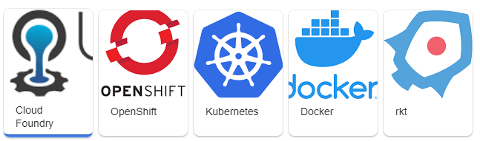
Containers
What is this Container-thing developers are talking about. And why should you use it? In this module you will get an overview of what containers are, and how to use them on and with Windows and Linux.
Why Containers?
Containers vs Virtual Machines
Linux, Windows and Hyper-V Containers
Container Orchestration

Slide 9
What is Docker?
Docker is a containerization platform used to develop, ship, and run containers. Docker doesn't use a hypervisor, and you can run Docker on your desktop or laptop if you're developing and testing applications. The desktop version of Docker supports Linux, Windows, and macOS. For production systems, Docker is available for server environments, including many variants of Linux and Microsoft Windows Server 2016 and above. Many clouds, including Azure, supports Docker.
What is a container?
A container is a loosely isolated environment that allows us to build and run software packages. These software packages include the code and all dependencies to run applications quickly and reliably on any computing environment. We call these packages container images.
The container image becomes the unit we use to distribute our applications.

Slide 10
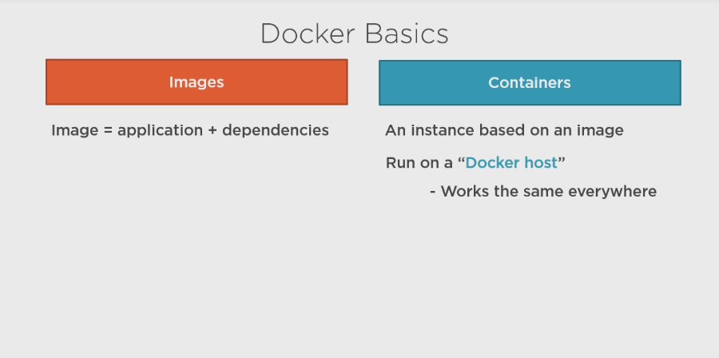

Slide 11
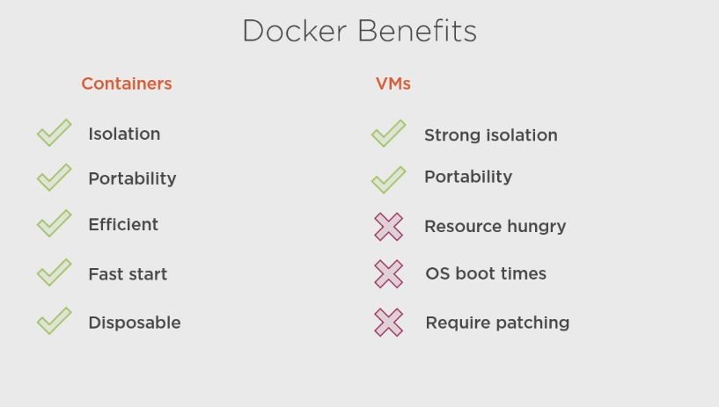

Slide 12
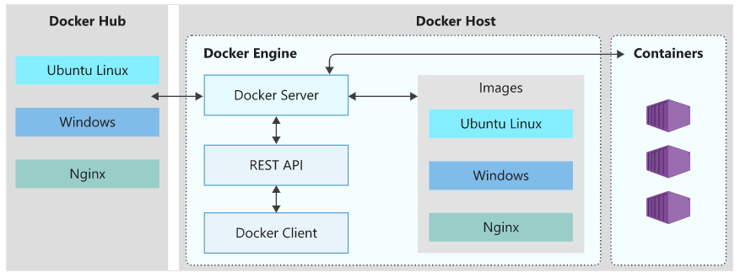
Docker architecture

Slide 13
The Docker client
The Docker client is a command-line application named docker that provides us with a command line interface (CLI) to interact with a Docker server. The docker command uses the Docker REST API to send instructions to either a local or remote server and functions as the primary interface we use to manage our containers.
The Docker server
The Docker server is a daemon named dockerd. The dockerd daemon responds to requests from the client via the Docker REST API and can interact with other daemons. The Docker server is also responsible for tracking the lifecycle of our containers.
Docker objects
There are several objects that you'll create and configure to support your container deployments. These include networks, storage volumes, plugins, and other service objects. We won't cover all of these objects here, but it's good to keep in mind that these objects are items that we can create and deploy as needed.
Docker Hub
Docker Hub is a Software-as-a-Service (SaaS) Docker container registry. Docker registries are repositories that we use to store and distribute the container images we create. Docker Hub is the default public registry Docker uses for image management.

Slide 14
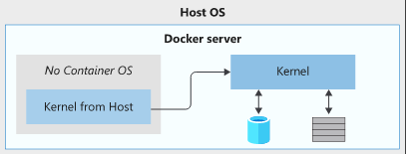
What is the host OS?
The host OS is the OS on which the Docker engine runs. Docker containers running on Linux share the host OS kernel and don't require a container OS as long as the binary can access the OS kernel directly.
Diagram showing a Docker image with no base OS and the dependency on the host OS Kernel.
However, Windows containers need a container OS. The container depends on the OS kernel to manage services such as the file system, network management, process scheduling, and memory management.

Slide 15
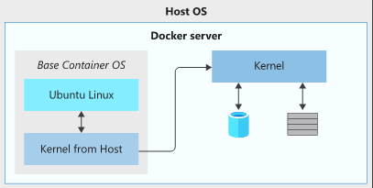
What is the container OS?
The container OS is the OS that is part of the packaged image. We have the flexibility to include different versions of Linux or Windows OSs in a container. This flexibility allows us to access specific OS features or install additional software our applications may use.
Diagram showing a Docker image with an Ubuntu base OS and the dependency on the host OS Kernel.
The container OS is isolated from the host OS and is the environment in which we deploy and run our application. Combined with the image's immutability, this isolation means the environment for our application running in development is the same as in production.

Slide 16
Now in real business applications we actually needs multiple containers to host our application in distributed environment across multiple clustered servers especially when we are using architecture like microservices.
Which introduces number of challenges like..

Slide 17
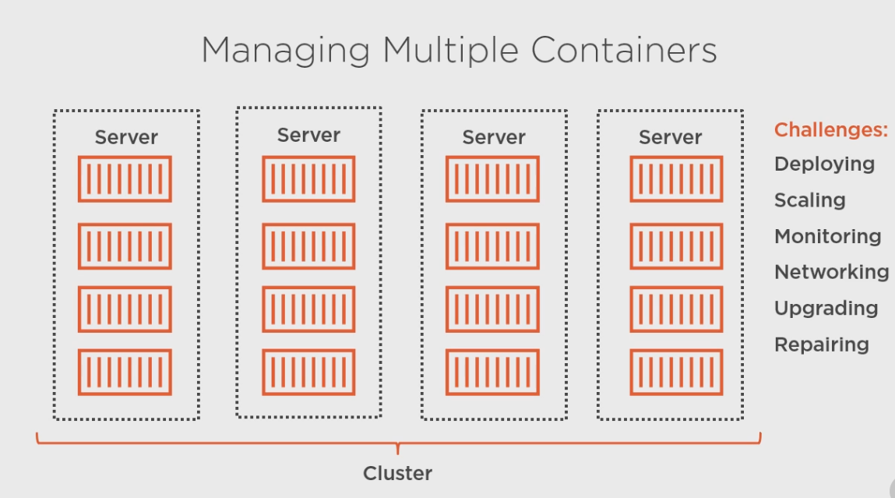

Slide 18
To handle these challenges orchestrator is coming in to the picture which will configure multiple nodes based on your clustered server requirements using YAML files
Some of the useful orchestrators are
Kubernetes
Service Fabric

Slide 19
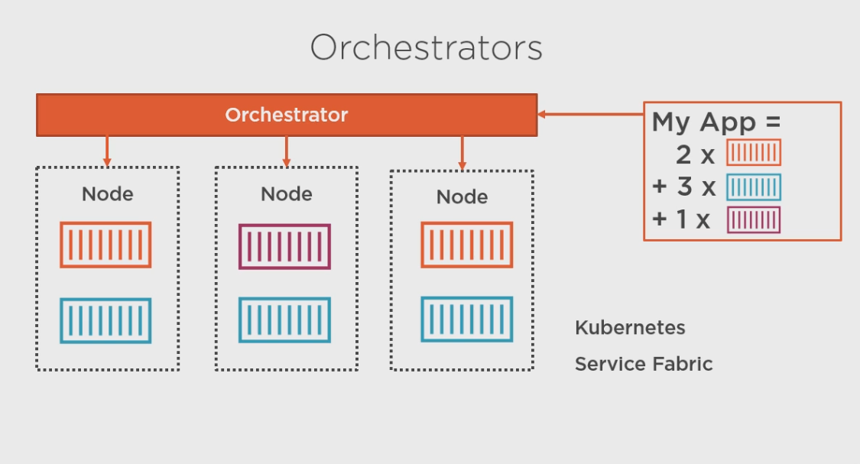

Slide 20
Docker-containerization platform
Image- app-code + Dep
Container- Instance of an image
Docker Client – CLI
Docker Server – create, run, manage images
REST API
Docker Hub – image repository
Kubernetes – container orchestrator tool

Slide 21
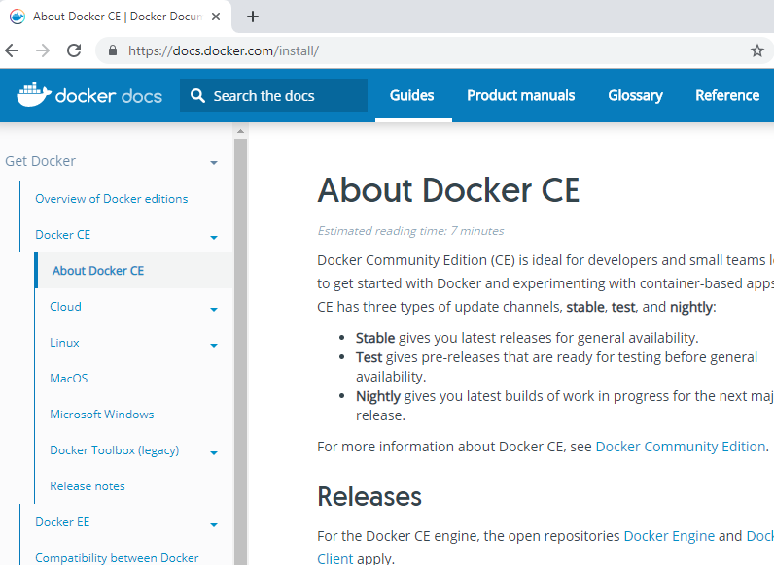

Slide 22
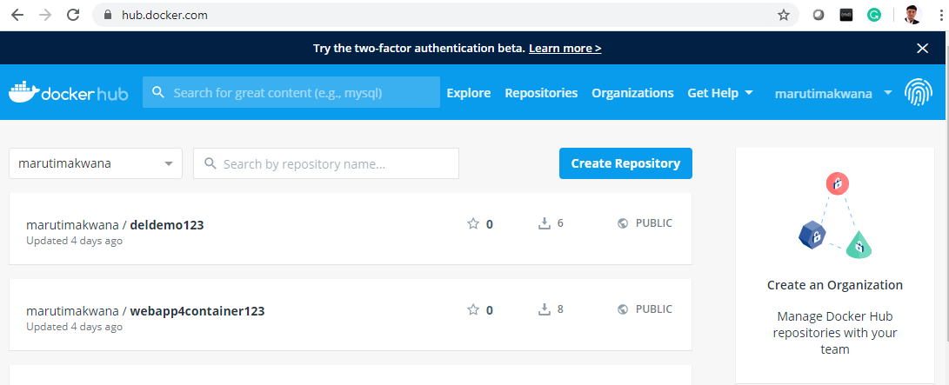

Slide 23
Download Docker For Windows and Install it
Then Login to it

Slide 24
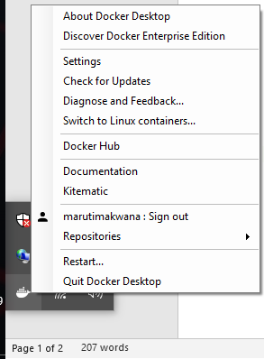

Slide 25
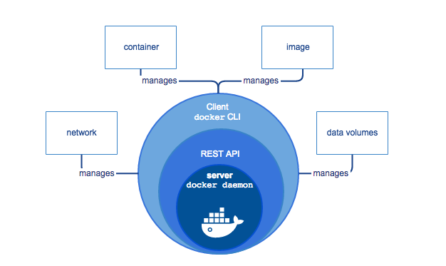

Slide 26
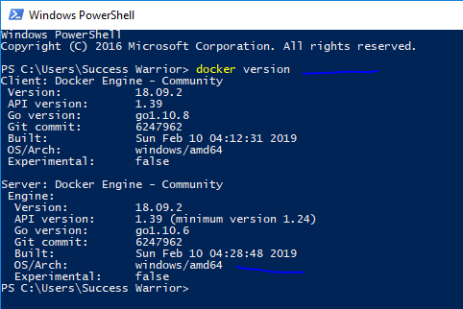
We are using windows containers

Slide 28
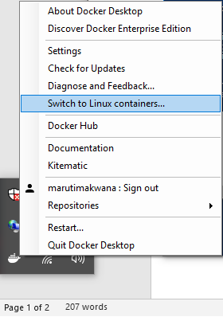
You can switch to linux containers
If your OS is supporting it

Slide 29
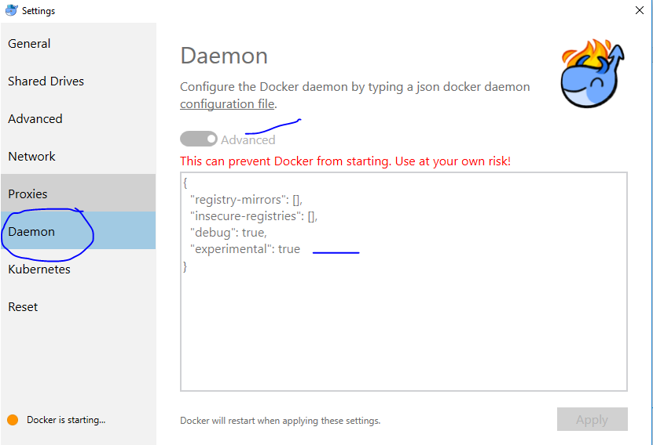

Slide 30
Image = code + dep
Container = instance of an image
Docker client = CLI for docker
Docker server = responsible for docker operations
Docker hub = image repository
Node = VM

Slide 31
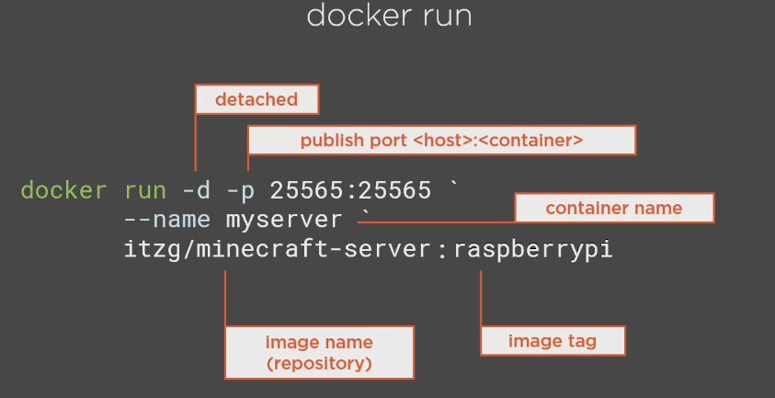

Slide 32
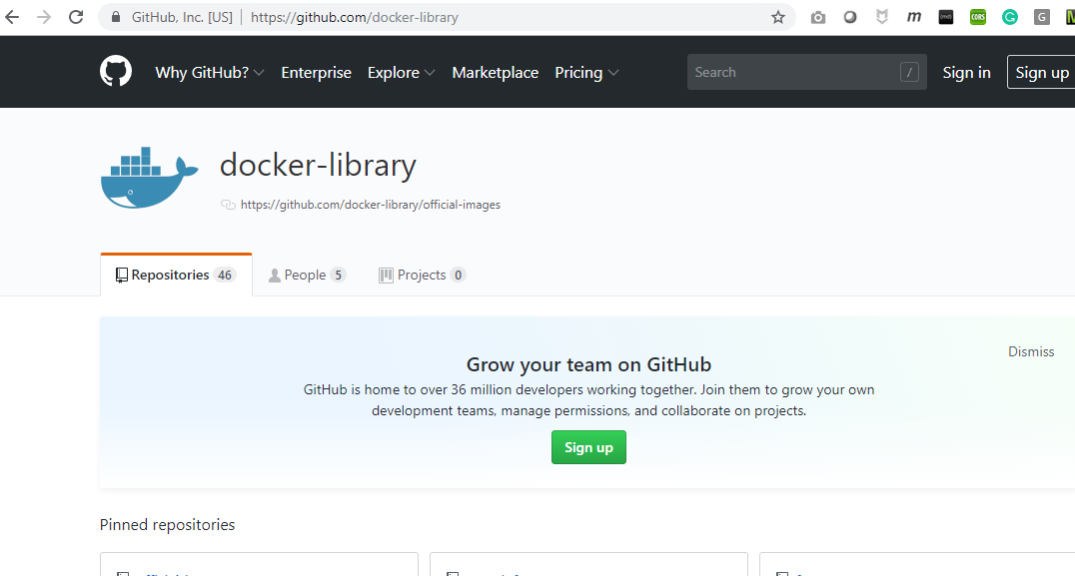
https://github.com/docker-library/official-images

Slide 33
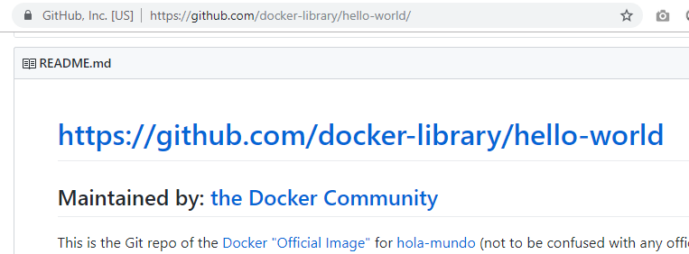
https://github.com/docker-library/hello-world

Slide 34
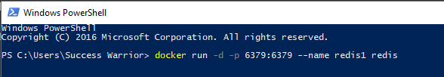
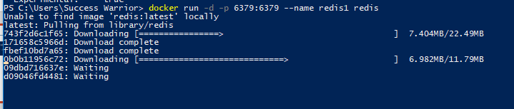
detach
Publish port host:container
Containername imagetag
docker run -d -p 6379:6379 --name redis1 redis

Slide 35
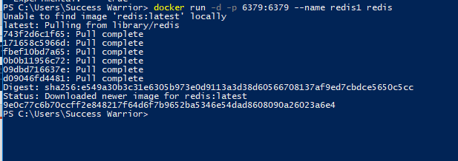
This is ID of newly created container

Slide 36
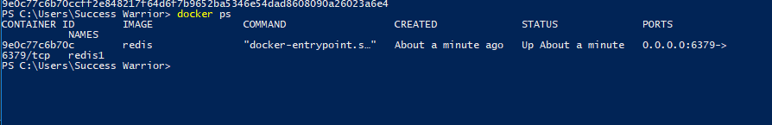
You can run docker ps command to see
What containers are running currently

Slide 37
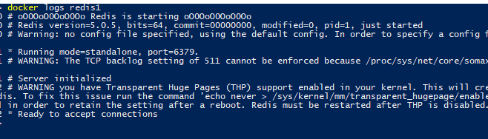
This will show logs of container and
You can see its ready to accept connections

Slide 38

This will give you list of docker images stored locally

Slide 39
Now I want to execute my container with shell
In interactive mode for my redis image which
We have created

Slide 40

Interactive
shell
docker exec -it redis1 sh
Fire this command and you will enter in shell
With #

Slide 41
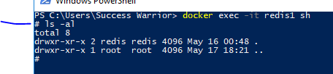

Showing me
File system of
container
Running redis cli

Slide 42
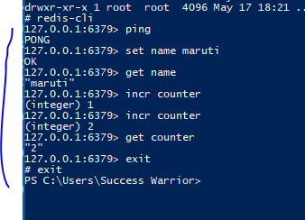

Slide 43
Can we run redis cli in different container and connect back to this first container?
Yes we can do that with docker run command like this

Slide 44

docker run -it --rm --link redis1:redisnew --name client1 redis sh
Sh-shell
It – interective
Rm- remove once done
Link – reference actual:newname

Slide 45

redis-cli -h redisnew
Will I get values of redis cache in this new container?

Slide 46
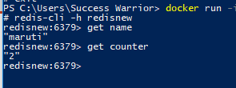

Slide 47
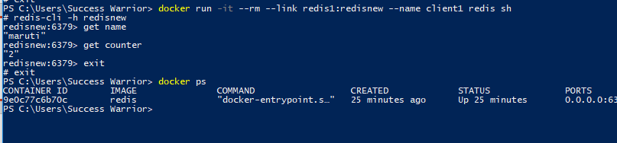
After exit from container its removed because of
--rm which we have given earlier so if you check
Docker ps you will get only one container in that

Slide 48

To stop any container
So now docker ps is not showing anything

Slide 49

This will show you that container and you can see
Its not running from status of it

Slide 50
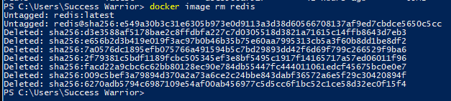

Slide 51
Docker version
Docker run
Docker ps
Docker images docker image ls
Docker ps –a
Docker stop
Docker rm
Docker image rm

Slide 52
https://docs.microsoft.com/en-us/learn/modules/intro-to-containers/3-exercise-deploy-docker-image-locally

Slide 53
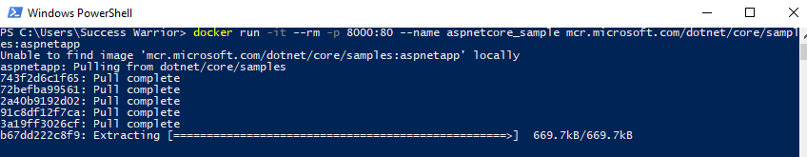
docker run -it --rm -p 8000:80 --name aspnetcore_sample mcr.microsoft.com/dotnet/core/samples:aspnetapp

Slide 54
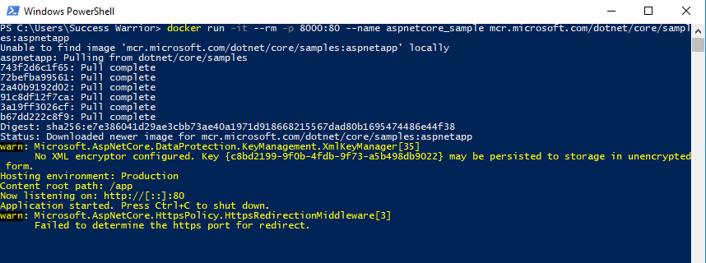

Slide 55
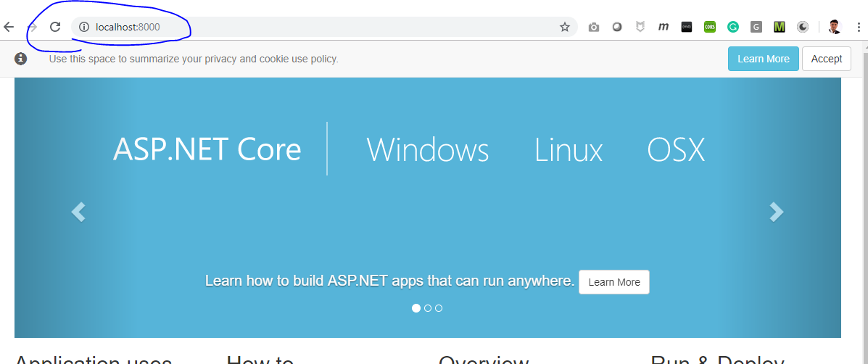

Slide 56
Image
Container
Docker hub
Docker version
Docker images
Docker ps
Docker image ls
Docker run
Docker stop
Docker rm ____
Docker image rm _____
Docker exec
Docker ps –a

Slide 57
2
1
3
Azure
VS-2019
Docker desktop
ACR

Slide 58
Docker Hub is an excellent source of images to get you started building your own containerized apps. You can download an image that provides the basic functionality you require, and layer your own application on top of it to create a new custom image. You can automate the steps for doing this process by writing a Dockerfile.
To create a Docker image containing your application, you'll typically begin by identifying a base image to which you add additional files and configuration. The process of identifying a suitable base image usually starts with a search on Docker Hub for a ready-made image that already contains an application framework and all the utilities and tools of a Linux distribution like Ubuntu or Alpine.

Slide 59
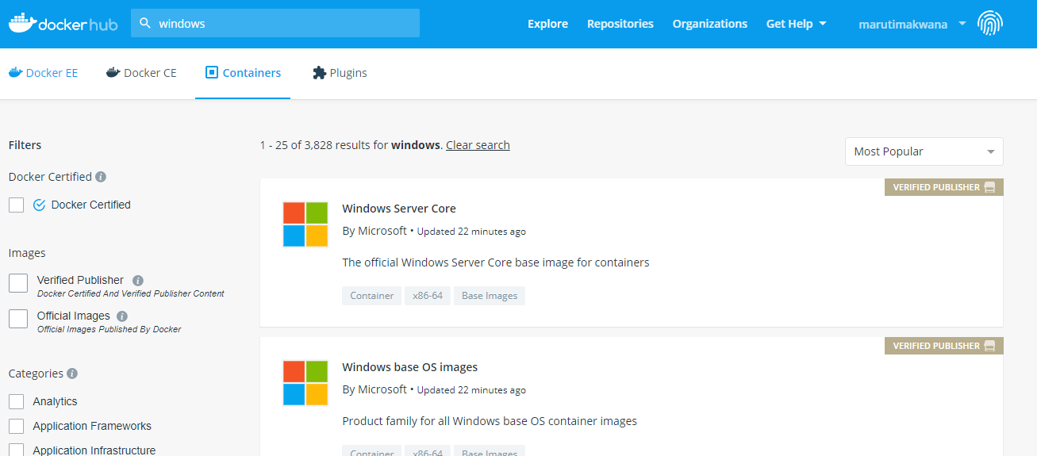

Slide 60
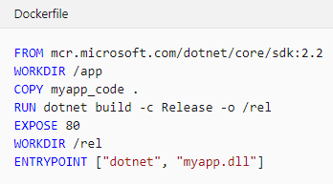
The FROM statement downloads the specified image and creates a new container based on this image.
The WORKDIR command sets the current working directory in the container, used by the following commands.
The COPY command copies files from the host computer to the container. The first argument (myapp_code) is a file or folder on the host computer. The second argument (.) specifies the name of the file or folder to act as the destination in the container. In this case, the destination is the current working directory (/app).
The RUN command executes a command in the container. Arguments to the RUN command are command-line commands.
The EXPOSE command creates configuration in the new image that specifies which ports are intended to be opened when the container is run. If the container is running a web app, it's common to EXPOSE port 80.
The ENTRYPOINT command specifies the operation the container should run when it starts. In this example, it runs the newly built app. You specify the command to be run and each of its arguments as a string array.

Slide 61
Docker images
Docker run
Docker ps
Docker images
Docker exec
Docker stop
Docker ps –a
Docker rm
Docker image rm

Slide 62
TASK Day 1
Docker host
Docker hub(public)
Azure
IMAGE
IMAGE
IMAGE
Dot Net

Slide 63
Docker host
Azure CR
Azure
IMAGE
IMAGE
IMAGE

Slide 64
Customize a Docker image to run your own web app
Without Visual Studio

Slide 65
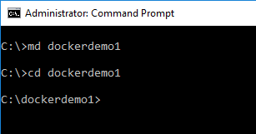

Slide 66
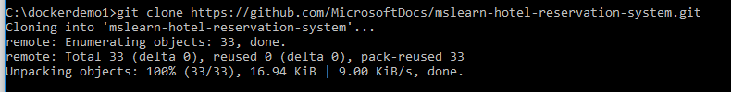
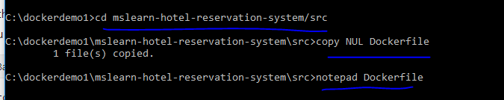
git clone https://github.com/MicrosoftDocs/mslearn-hotel-reservation-system.git

Slide 67
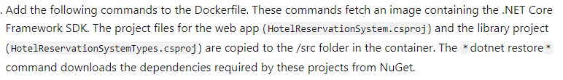
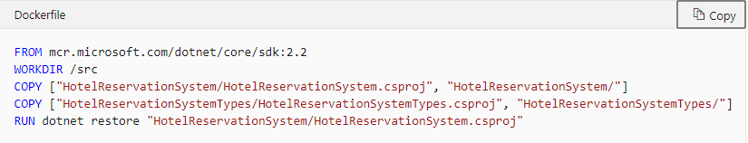

Slide 68
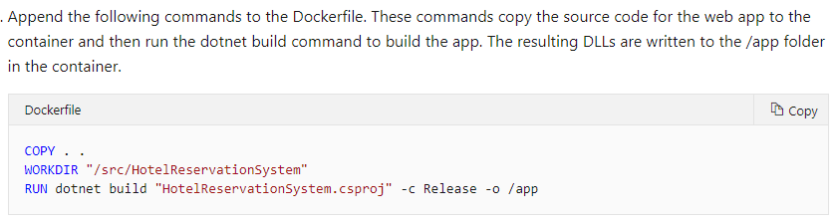

Slide 69
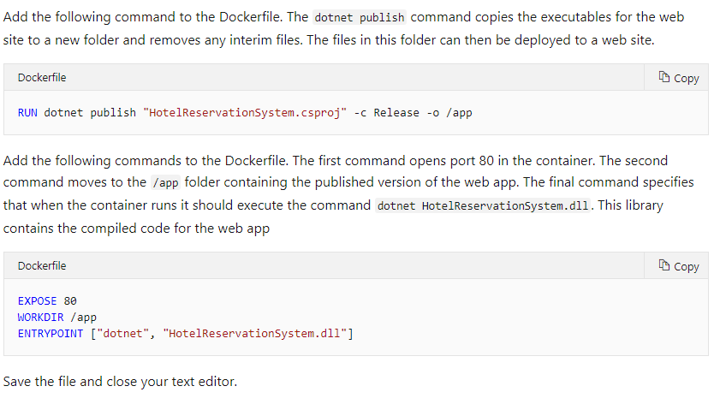

Slide 70
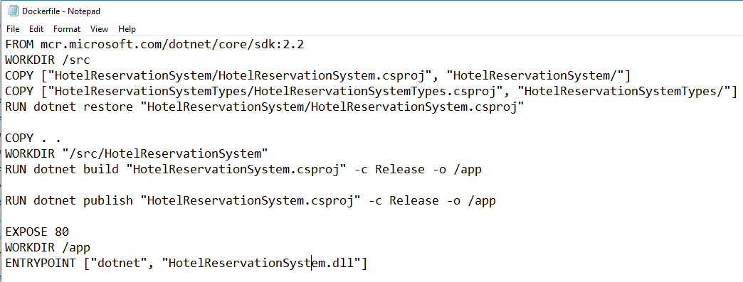

Slide 71
FROM mcr.microsoft.com/dotnet/core/sdk:2.2
WORKDIR /src
COPY ["HotelReservationSystem/HotelReservationSystem.csproj", "HotelReservationSystem/"]
COPY ["HotelReservationSystemTypes/HotelReservationSystemTypes.csproj", "HotelReservationSystemTypes/"]
RUN dotnet restore "HotelReservationSystem/HotelReservationSystem.csproj"
COPY . .
WORKDIR "/src/HotelReservationSystem"
RUN dotnet build "HotelReservationSystem.csproj" -c Release -o /app
RUN dotnet publish "HotelReservationSystem.csproj" -c Release -o /app
EXPOSE 80
WORKDIR /app
ENTRYPOINT ["dotnet", "HotelReservationSystem.dll"]

Slide 72


docker build -t reservationsystem .
At the command prompt, run the following command to build the image for the sample app using the Dockerfile. Don't forget the . at the end of the command. This command builds the image and stores it locally. The image is given the name reservationsystem. Verify that the image is built successfully. A warning about file and directory permissions will be displayed when the process completes. You can ignore these warnings as developers never cares for warnings.

Slide 73
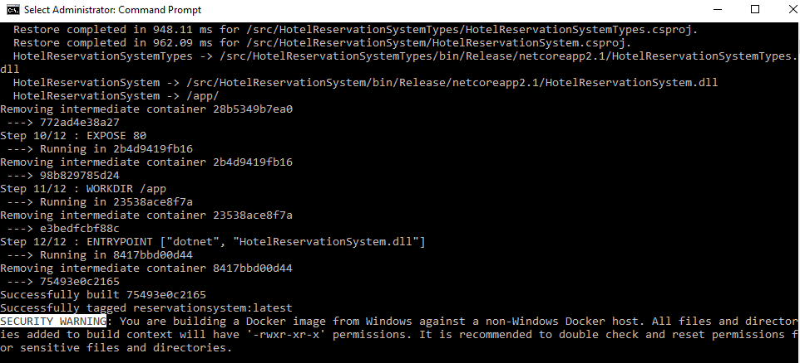

Slide 74
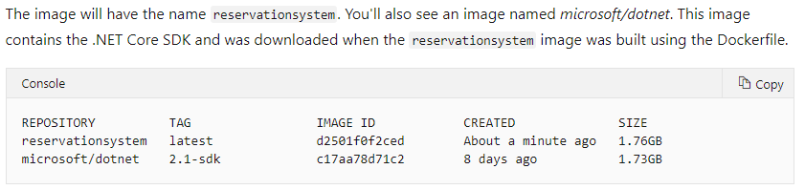
docker image list

Slide 75
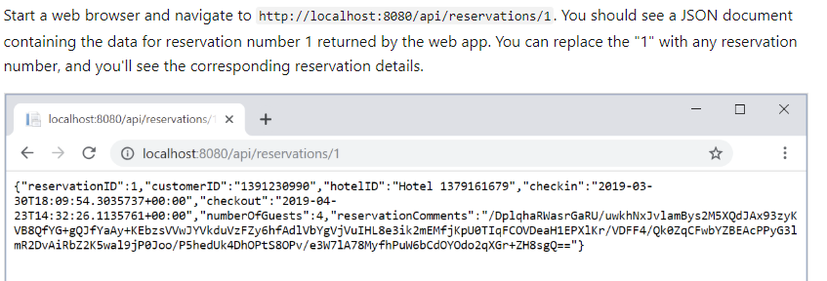
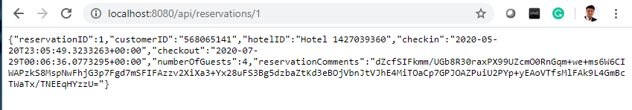
docker run -p 8080:80 -d --name reservations reservationsystem
Run a container

Slide 76
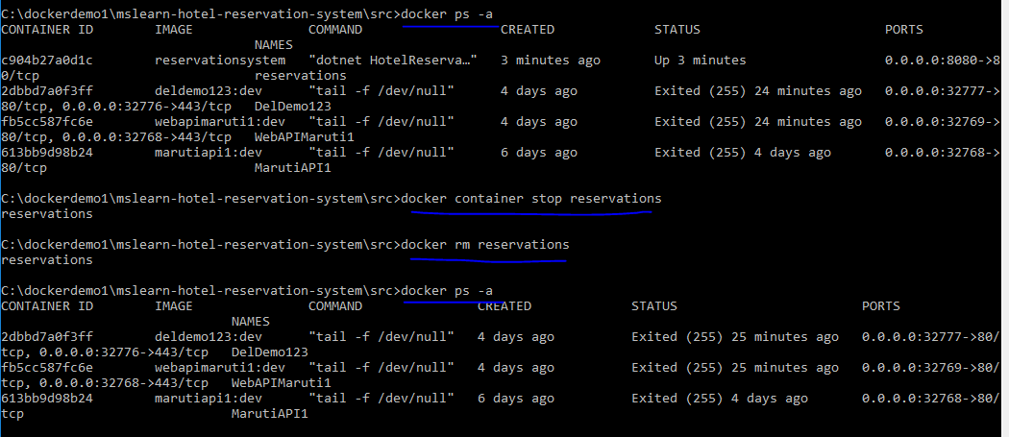
docker ps -a

Slide 77
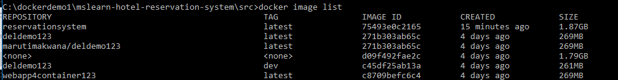
Container is Removed but Image is still there

Slide 78
https://docs.microsoft.com/en-us/learn/modules/intro-to-containers/5-exercise-create-custom-docker-image
Customize a Docker image to run your own web app
git clone https://github.com/MicrosoftDocs/mslearn-hotel-reservation-system.git
cd mslearn-hotel-reservation-system/src
copy NUL Dockerfile
notepad Dockerfile
Dockerfile Code
FROM mcr.microsoft.com/dotnet/core/sdk:2.2
WORKDIR /src
COPY ["HotelReservationSystem/HotelReservationSystem.csproj", "HotelReservationSystem/"]
COPY ["HotelReservationSystemTypes/HotelReservationSystemTypes.csproj", "HotelReservationSystemTypes/"]
RUN dotnet restore "HotelReservationSystem/HotelReservationSystem.csproj"
COPY . .
WORKDIR "/src/HotelReservationSystem"
RUN dotnet build "HotelReservationSystem.csproj" -c Release -o /app
RUN dotnet publish "HotelReservationSystem.csproj" -c Release -o /app
EXPOSE 80
WORKDIR /app
ENTRYPOINT ["dotnet", "HotelReservationSystem.dll"]
End Docker File
docker build -t reservationsystem .
docker image list
docker run -p 8080:80 -d --name reservations reservationsystem
try this in web browser
http://localhost:8080/api/reservations/1
docker ps -a
docker container stop reservations
docker rm reservations

Slide 79

Deploy a Docker image to an Azure Container Instance

Slide 80


Slide 81


Slide 82


Slide 83

Make a note of the Registry name, Login server, Username, and password for your registry.

Slide 84
Registry name, marutiACR123
Login server, marutiacr123.azurecr.io
Username, marutiACR123
password m/BKhNlTfbtpUKC4ZtMKru8r71p=aoQy

Slide 85

docker tag reservationsystem:latest marutiACR123.azurecr.io/reservationsystem:latest

Slide 86


Slide 87


docker login marutiacr123.azurecr.io -u marutiACR123 -p m/BKhNlTfbtpUKC4ZtMKru8r71p=aoQy

Slide 88


docker push marutiACR123.azurecr.io/reservationsystem:latest

Slide 89
There are chances that you will get authentication required message
In this case we need to authenticate with Azure AD
Which we will see later
On completion you will get this image on azure Container registry like this

Slide 90


Slide 91


Slide 92


Slide 93



Slide 94


Slide 95


Slide 96


Slide 97


Slide 98



